Slide 1
Risk Overview
—— Special for freshmen of risk
Sept 2018

Slide 2
Agenda
Risk & Payment
Risk Types And Fund Loss
Risk Architecture Of Philippine Site
Future Trends and Our Target

Slide 3
01
Risk & Payment
Part One

Slide 4
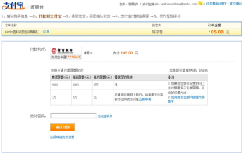






Risk Basic Theory
Rule
Data
Cashier
Risk Engine
Model
UID | Type | Transaction Type | Category | Time | Amoun t
1001 | Payment | Instant transfer | Go Dutch | 2014.05.13 17:10 | 50
1001 | Payment | Secured Transaction | cosmetic | 2014.04.26 16:08 | 900
1001 | Payment | Secured Transaction | Underwear | 2014.04.25 15:00 | 150
1001 | Payment | Instant transfer | Pay Bill | 2014.04.24 11:50 | 100
1001 | Payment | Secured transaction | Swim Suit | 2014.04.23 10:40 | 100
1001 | Payment | Secured transaction | Outfit | 2014.03.27 11:35 | 300
Risk Analyze Process
.
Event Transform ->Risk Event Model
Data Collection(Current operation，Current Value，Historical Behavior etc.)
Rule/Model risk analyze
Risk Control (Fail/Verification/Biz Limit etc)

Slide 5
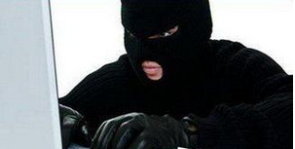
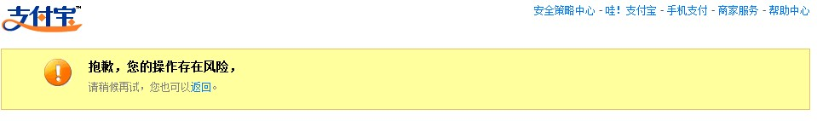
Risk Basic Theory
Rule
Data
Cashier
Failed Biz
Risk Engine
Model
UID | Type | Txn type | Category | Time | Amount
1001 | Payment | Auto Ship | Game Card | 2014.05.23 02:30 | 200
1001 | Payment | Auto Ship | Game Card | 2014.05.23 01:40 | 100
1001 | Payment | AutoShip | Game Card | 2014.05.23 01:23 | 1
1001 | Payment | Instant Trans | Go Dutch | 2014.05.13 17:10 | 50
1001 | Payment | Secured Txn | Costume | 2014.04.26 16:08 | 900
1001 | Payment | Secured Txn | 情趣内衣 | 2014.04.25 15:00 | 150
Analyze Result
Untrusted
Untrusted
Untrusted
trusted
trusted
trusted
Sorry, we detect risk in the transaction.
You can try again later or return.
High Risk

Slide 6
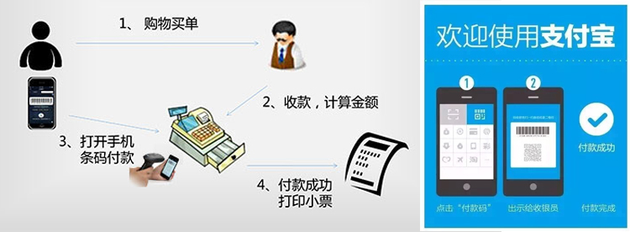

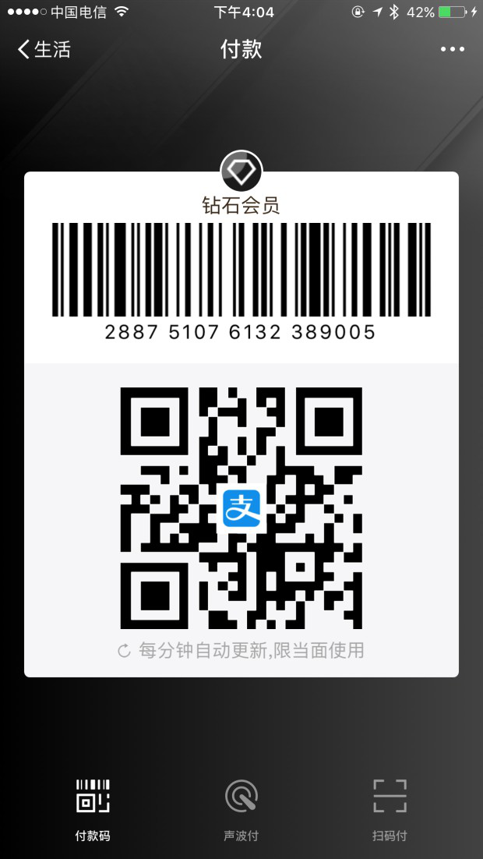
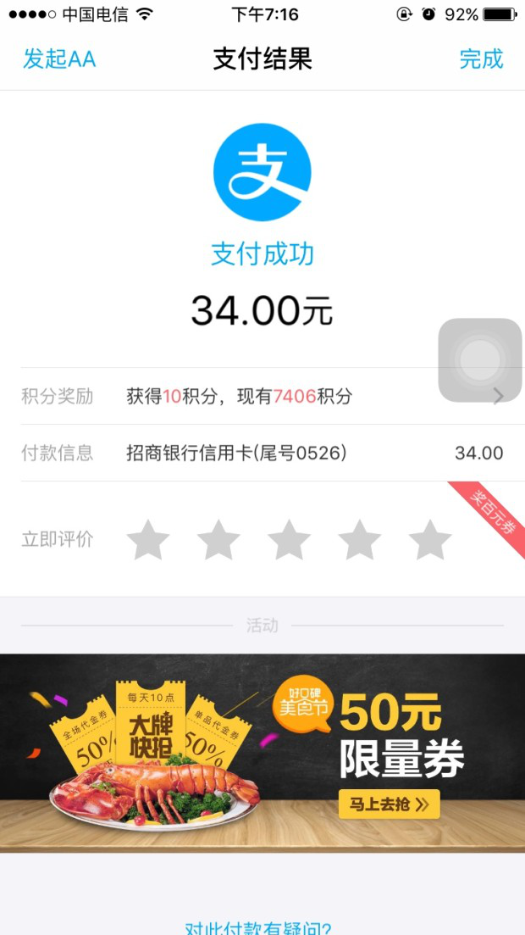
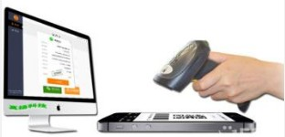
B Scan C —— Normal payment
Shopping
Calculate, Charge
Show
Code
Payment Success
A--M-->B
payer_token: 2843221
payer_uid: xxxx
-M
A
+M
B
√
Show Code
Merchant Scan
Decode Request
Risk Analyze
Payment Deduction
Result Display

Slide 7
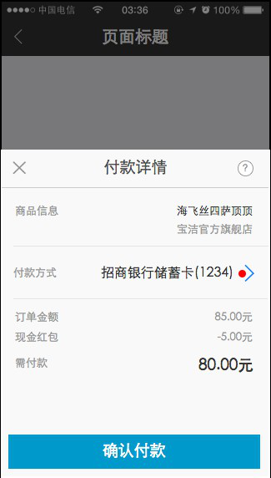
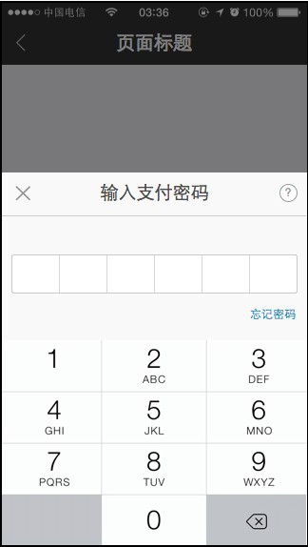
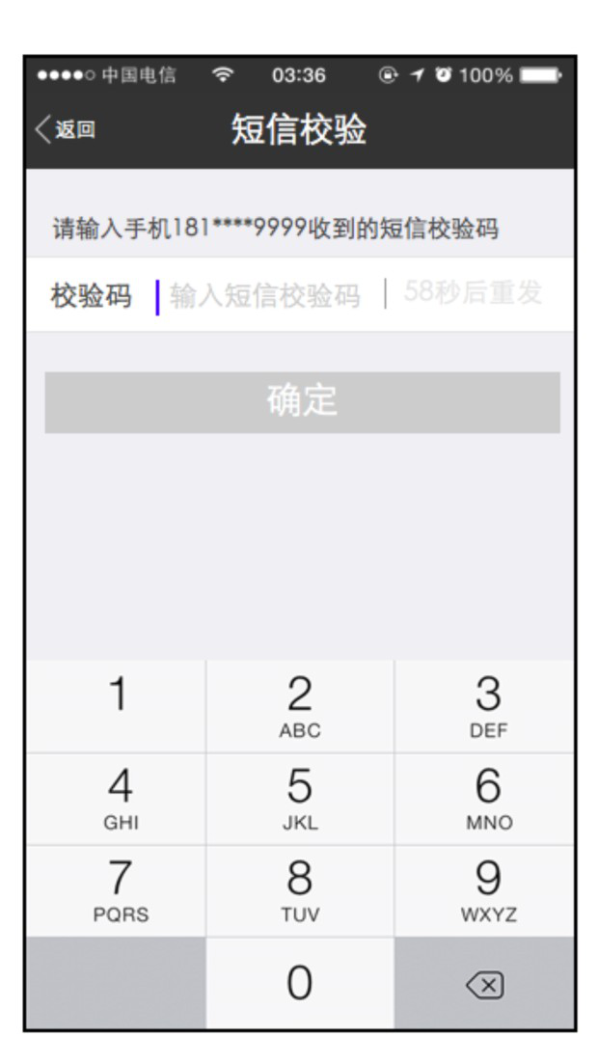
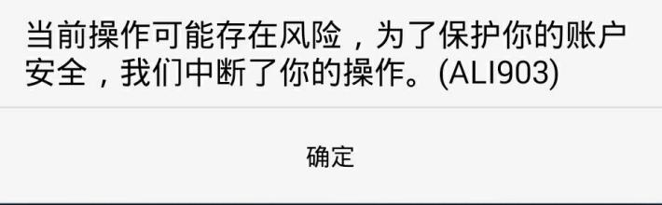

Scan to pay—— Full Process
Risk detected, we block the operation for your safety. (ALI903)
OK
?
Risk Challenge
×
Risk Control
Risk Audit
Online Cashier
Payment Auth
Risk Analyze
×
×
√
A--M-->B
payer_token: 2843221
payer_uid: xxxx
-M
A
+M
B
√
ShowCode
Scan
Decode
Risk Analyze
Payment Deduct
Show Result

Slide 8
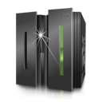
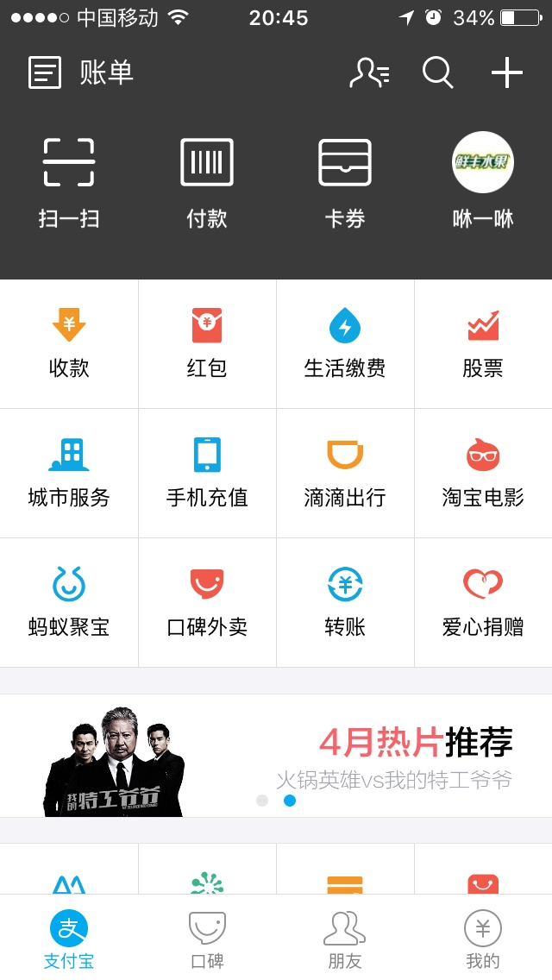

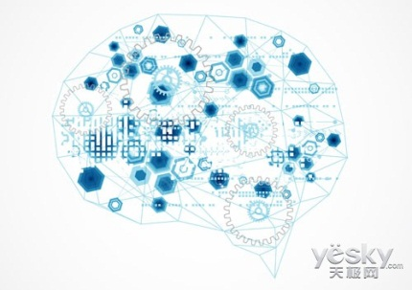




Risk Control Process
Payment/Login Request
Event Collection
IP
Mac
Order Info
……
No Fund Loss
Login/Payment Success
No/Low Risk
Txn Time
Txn Amount
Txn Habit
Normal Env
……
Fund Loss
Risk Analyze
Ant Risk System
Normal activity
High Risk
Case Audit
Challenge
Compensation
Hear case
Risk Activity

Slide 9
02
Risk Types And Fund Loss
Part One

Slide 10
Risk types of financial systems
::Risks
Account
Fraud
Fake Txn
Operation
Social Network
Money Laundering
Passive risk
Garbage Accounts
Merchant Fraud
Cash Out
Merchant Violation
Social Garbage Account
Merchant Money Laundering
Passive Stolen Item Sale
Account Take Over
Card Stolen
Cheat
Merchant operation
Social Network Cheat
Personal Money Laundering
Mobile Loss
Merchant Qualification
Single Brush
Trojan horse Of Mobile

Slide 11
GCash business and risks
Payment
Buy Load
Lazada
Online shopping
QR Payment
Cash in/Out
Movie Ticket
Anti Fraud
Account Take Over
Card Stolen
Personal Fraud
Promotion abuse
Social Service
Bill Payment
Social Risk
Social Fraud
Social Account Take Over
Garbage Information
Gambling/Money Laundering
Information Leak
Financial Service
Borrow Load
GCredit
Fuse
Marketing Risk
Credit Risk

Slide 12
Case study 1—— Mobile Loss
Overview：
User mobile lost or robbed， thief use software crack the screen lock, crack the wallet by using private information stored in mobile phone and get the fund from e-wallet
No screen lock or crack lock by hack software；
Login Wallet, get profit from small amount no pass or scan to pay
User credit card or OTP to reset wallet password
Thief
Get the lost mobile phone；
Or
User
No sense, no Loss report, no card renew

Slide 13
Case Study 2 —— Fishing
Overview：Lure user to visit fishing sites, and fill in private information, use those information to take over account
Cheater
Be merchant of e-commerce platform, such as Taobao, Lazada, publish low price goods
Use social tools, send fake ecommerce site url, fishing site, cheat user to click and fill in forms
User account/pass info from fishing site to login e-wallet, and get benefits
User
Lured by cheap goods, contact merchants (Cheater) by social tools
Treat fishing sites as normal website, fill in user account/password, verification code
Cheater
In social platform such as Twitter, Weibo, broad cast information about credit card application, credit card cash out, put fishing site URL in those information.
User those information login to e-wallet and get funds.
User
Lured by the information, input personal information
被盗者
钓鱼是多种作案手法的源头。

Slide 14
Risk control Basic Theory
Big Data + Domain Expertise
Account
Counterparty
Behavior
Conflicts
Mutation
Normal Intention Of Abnormal Behavior
device
Environment
Transaction
Relationship
Know user intention
Precisely
Abnormal Intention of Normal Behavior
By real-time decision risk engine, apply risk control policy for those operations with abnormal intention. For example, user OTP, face, KBA verification methods to verify user identity, block user operation, limit user access, deep risk analyze, even expert audit

Slide 15
03
Risk Architecture Of Philippine Site
Part One

Slide 16




Current Architecture
GCash APP
GCash Facebook Messenger
USSD
Partner
Merchant
Risk Integrated
GCash
Global
Third Party
App MW
GCOMega
Quest
Mambu
Core
DFP Center
ESB （Risk integration Layer）
Risk Integrated Channel）
DFP Algorithm
Root detect
Simulator Detect
Register
Login
Cash in
Buy Load
Borrow Load
Reset Pin
P2P
Risk
Payment Risk
Risk Operation
Offline Risk Compute
Glocal Rule Center
ATO
Card Stolen
Risk Rule Operation
PA Risk Offline Compute
Rule Config
Rule Pack
Rule Trans
Risk Engine
Back Office
Monitoring
BasicPPlat
ODPS
Xflush
ElasticSearch
Indicator Plat
PAI
…

Slide 17
Risk Architecture FY2019
GCash APP
（DFP/Identity SDK Inside）
Web Cashier
GCash Facebook Messenger
USSD
Partner
Merchant
Global
Alipay+
GCash
App MW
GCOMega
Quest
Core
Acquiring
Merchant
Promotion
Cashier
ESB （Risk integration Layer）
DFP Center
Register
Login
Cash in
Buy Load
Banks Channels
DFP Algorithm
Root Detect
Simulator Detect
Borrow Load
Reset Pin
P2P
QR Code
Paypal
Payment
Risk Operation
Offline Risk Compute
Verification Platform
ATO
Card Stolen
PA
Policy Operation
Risk Audit
PA Comute
NSF
Unified Verification
Risk Insight
Rule Operation
Smart Operation
Risk Visual
Monitoring
Glocal Risk Center
Risk Engine（AI Decision）
Risk Engine
Verification
Identity Product
Rules Config
Rules Pack
Rule Transfer
Global Monitor
Event Component
T Component
Fingerprint
Event Mgmt
Comm query
Indicators Overview
Model Component
Rule Mgmt
Cases Mgmt
Data Washing
Rule Component
OTP…
Zoloz
Variable
Group Analyze
Alert
数据
Deployment
User Protrait
Deep Analyze
ZHub
标准
事件
标准策略
标准
变量
联防
名单
…
…
…
…
ZCore
ZMng
基础
平台
ODPS
Xflush
Elastic Search
特征中台
PAI
…

Slide 18
04
Future Trends, Target
Part One

Slide 19
Security & Risk Trends
Trends 1
Trends 2
Trends 3
Fraud Risk Control Became Harder and Harder
Identity Leak
Professional, Hidden Skills evolution
Identify, Proof, Disposal
Dark side enlarged on internet
New technology large scale applying Bring Challenge for security and risk
Cloud Computing
AI
IOT
Block Chain
Private protection and Data security conflict with risk control
Cross border risk control net
Citizenship sense
Laws and Rules
Open ecosystem

Slide 20
Target
Risk Ability Enhance
Biz
Biz Scene and Fund Channel Coverage（Buy Load, P2P, Cashi in/out, BPI, Paypal….)
A+ offline, online, promotion battle
Make Risk Control A Core Advantage Of GCash
Prod
User Experience
Bio identity
No Password payment（QR Code and Scan to pay)
Reset pin flow improve
Promote PA Ability
Let promotion brings true growth
Oper
Local Risk Operation
Risk Organization
Risk rule and operation ablity风控规则能力与运营能力
Data mining and model analyze
Improve User Experience
Let payment more safe, more smooth
Platform
Tech
Risk Engine upgrade（Airmind）
Smart risk engine
Risk auto analyze
Risk visual and operation tool
Capacity
Monitoring Ability
* 仅限内部交流使用，如果需要公开，请联系文档作者

Slide 21

Thank You
Jerry Li
www.antfin.com

